Slide 1
PIE & AI
AI Global leaders
and
community
deeplearning.ai

Slide 2
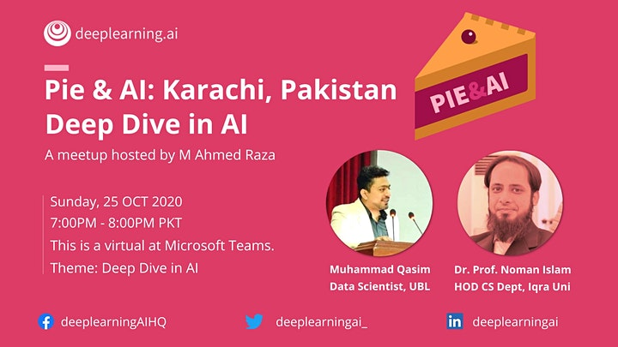

Slide 3
Topics
Introduction to AI
Machine Learning
ML Learning types
Deep learning
ANN, CNN, RNN and LSTM
Career in AI

Slide 4
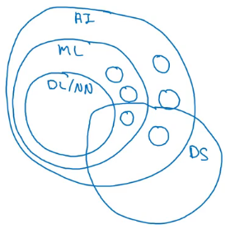
AI and related disciplines
Machine Learning
Data Science
Deep Learning / Neural Network
Supervised Learning
Unsupervised learning
Reinforcement Learning

Slide 5
Artificial Intelligence
Symbolic A.I / Classical Programming
Machine Learning
Deep Learning

Slide 6
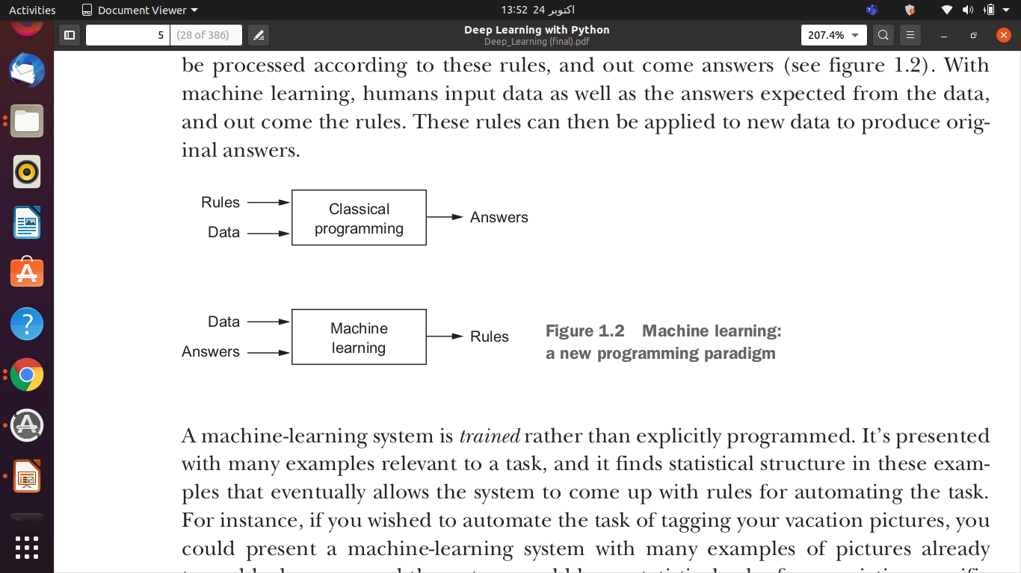
Artificial Intelligence
Symbolic A.I / Classical Programming

Slide 7
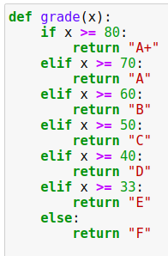
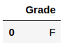
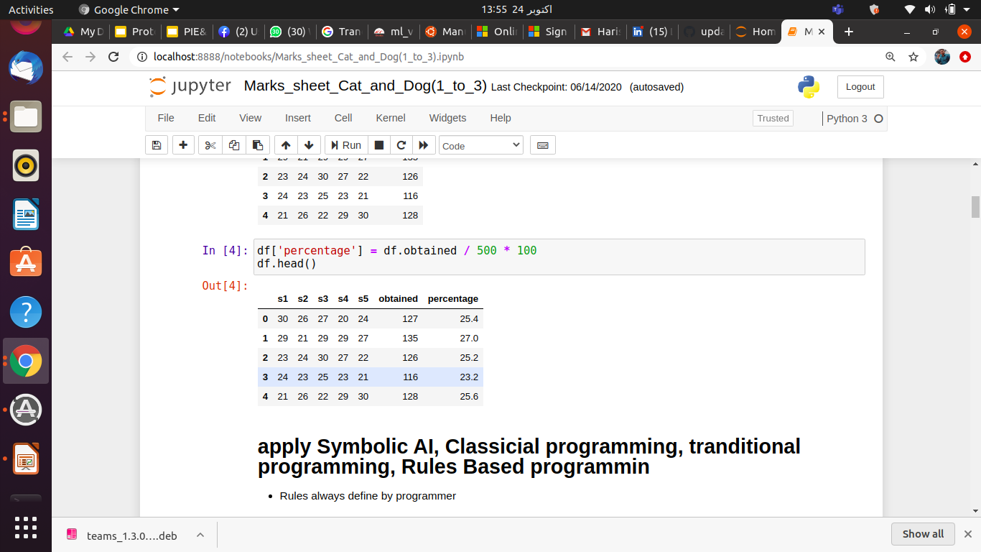
Artificial Intelligence
Symbolic A.I / Classical Programming
Rules
Output
Input

Slide 8
Artificial Intelligence
Machine Learning
There are lots of Algorithms like: (Naive Bayes, Decision Tree, Random Forest etc.
Deep Learning
Feature Engineering will be Automated
Always Use Neural Network

Slide 9
Artificial Intelligence
Machine Learning
Deep Learning
Data
Rules
Answer

Slide 10
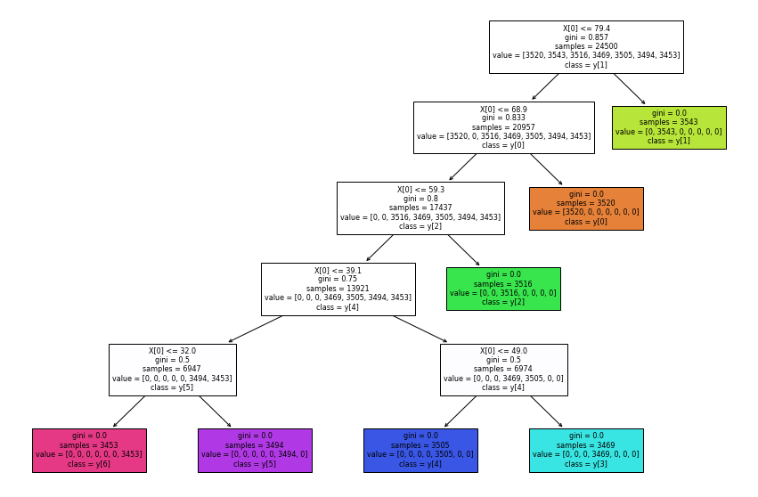
Artificial Intelligence
Machine Learning
Get Rules from ML

Slide 11
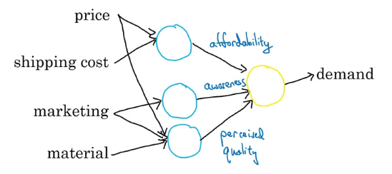
Artificial Intelligence
Deep Learning
Feature Engineering should be Auto
Always use Neural Network

Slide 12
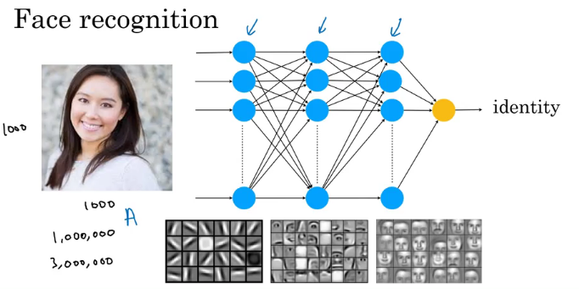
Artificial Intelligence
Deep Learning
Feature Engineering will be Automated
Always use Neural Network

Slide 13
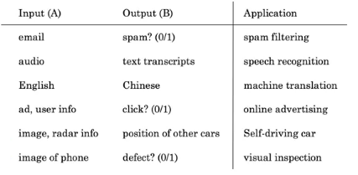
Supervised learning tasks

Slide 14
Learning Types in AI
Supervised learning tasks

Slide 15
Learning Types in AI
Unsupervised learning tasks

Slide 16
Learning Types in AI
Reinforcement learning tasks

